Slide 1

Module 8: Securing Network Traffic by Using IPSec and Certificates

Slide 2

Overview
Implementing IPSec
Implementing IPSec with Certificates
Monitoring IPSec

Slide 3
Lesson: Implementing IPSec
Multimedia: The Role of IPSec in a Network Infrastructure
What Is IPSec?
How IPSec Secures Traffic
What Is an IPSec Security Policy?
How IPSec Policies Work Together
Guidelines for Balancing Security and Performance
How to Assign or Unassign an IPSec Policy on a Computer

Slide 4


Multimedia: The Role of IPSec in a Network Infrastructure
The objective of this presentation is to describe how IPSec is used to ensure secure private communications over IP networks
At the end of this presentation, you will be able to:
  Explain what IPSec is
  Describe how IPSec works
  Describe how IPSec policies work

Slide 5

What Is IPSec?
IPSec is an industry-defined set of standards that verifies, authenticates, and encrypts data at the IP packet level. IPSec is used to provide data security for network transmissions
Benefits of IPSec:
Mutual authentication before and during communications
Confidentiality through encryption of IP traffic
Integrity of IP traffic by rejecting modified traffic
Prevention against replay attacks

Slide 6






How IPSec Secures Traffic
1
Active Directory
IPSec Policy
IPSec Policy
Security Association Negotiation (ISAKMP)
2
TCP Layer
TCP Layer
IPSec Driver
IPSec Driver
3
Encrypted IP Packets

Slide 7
What Is an IPSec Security Policy?
IPSec uses rules and policies to secure network traffic
Rules are composed of:
  A filter
  A filter action
  An authentication method
Default polices include:
  Client (Respond Only)
  Server (Request Security)
  Secure Server (Require Security)

Slide 8
How IPSec Policies Work Together
 | No policy assigned | Client (Respond Only) | Server (Request Security) | Secure Server (Require Security)
No policy assigned | No IPSec | No IPSec | No IPSec | No communication
Client (Respond Only) | No IPSec | No IPSec | IPSec | IPSec
Server (Request Security) | No IPSec | IPSec | IPSec | IPSec
Secure Server (Require Security) | No communication | IPSec | IPSec | IPSec

Slide 9
Guidelines for Balancing Security and Performance
Properly balancing minimal, standard, and high security levels requires:
Assessing the risk and determining the appropriate level of security
Identifying valuable information
Determining how the policies can best be implemented
Ensuring that management and technology requirements are in place
Providing all users with both secure and efficient access

Slide 10
How to Assign or Unassign an IPSec Policy on a Computer
Your instructor will demonstrate how to:
Add an IP Security Management Console and then assign or unassign an IPSec policy for a local computer policy
Assign or unassign an IPSec policy for an Active Directory-based Group Policy

Slide 11

Practice: Implementing IPSec
In this practice, you will assign an IPSec policy

Slide 12
Lesson: Implementing IPSec with Certificates
What Is a Certificate?
Common Uses of Certificates
Why Use Certificates with IPSec to Secure Network Traffic?
Multimedia: Certificate Enrollment
How to Configure IPSec to Use a Certificate

Slide 13
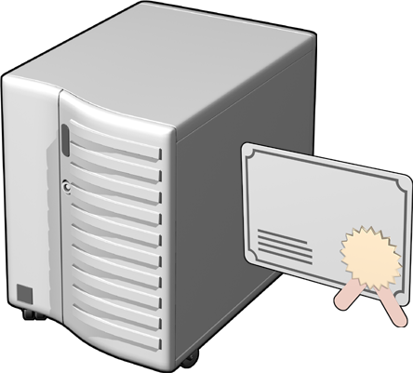
What Is a Certificate?
Certificates are an electronic credential that authenticates a user on the Internet and intranets
Certificates:
Securely bind a public key to the
entity that holds the corresponding private key
Are digitally signed by the issuing certificate authority (CA)
Verify the identity of a user, computer,
or service that presents the certificate
Contain details about the issuer
and the subject

Slide 14



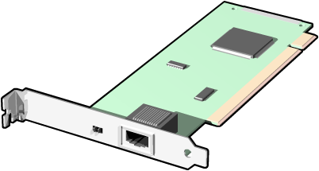




Common Uses of Certificates
Internet Authentication
Encrypting File System
Digital Signatures
IP Security
Secure E-Mail
Smart Card Logon
Software
Code Signing

Slide 15
Why Use Certificates with IPSec to Secure Network Traffic?
IP Security
Configure IPSec to use certificates:
To allow an enterprise to interoperate with other organizations that trust the same CA
When you need a higher level of security than provided by the Kerberos protocol or preshared keys
For clients that are not part of an Active Directory structure or do not support the Kerberos protocol

Slide 16
Multimedia: Certificate Enrollment
The objective of this presentation is to provide a high-level overview of certificate enrollment
At the end of this presentation, you will be able to:
  Define certificate enrollment
  Describe how certificate enrollment works

Slide 17
How to Configure IPSec to Use a Certificate
Your instructor will demonstrate how to configure IPSec to use a certificate

Slide 18
Practice: Implementing IPSec with Certificates
In this practice, you will implement IPSec with a certificate

Slide 19
Lesson: Monitoring IPSec
IP Security Monitor
Guidelines for Monitoring IPSec Policies
How to Stop and Start the IPSec Services
How to View IPSec Policy Details

Slide 20
IP Security Monitor
Use the IP Security Monitor to view details about IPSec policies such as:
Active IPSec policy details
  Name
  Description
  Date last modified
  Store
  Path
  Organizational unit and Group Policy object (GPO) name
Main mode statistics
  Information from the Internet Key Exchange
Quick mode statistics
  Information about the IPSec driver

Slide 21
Guidelines for Monitoring IPSec Policies
To help isolate the cause of a communication issue:
Stop the IPSec Policy Agent on the computers and use the ping command to verify communications between them
Restart the IPSec Policy Agent and use the IP Security Monitor to confirm that a security association is established between the computers, and the policy is in effect
Use IP Security Policy Management to verify that the policies are assigned to both computers
Use IP Security Policy Management to review the policies and ensure they are compatible with each other
Restart the IP Security Monitor to ensure that all changes are applied

Slide 22
How to Stop and Start the IPSec Services
Your instructor will demonstrate how to:
Stop and start the IPSec services by using the Windows interface
Stop and start the IPSec services by using the command prompt

Slide 23
How to View IPSec Policy Details
Your instructor will demonstrate how to:
View IPSec Active Policy details by using the IPSec Security Monitor
View IPSec Active Policy Main Mode Security Associations by using the IP Security Monitor

Slide 24
Practice: Monitoring IPSec
In this the practice, you will monitor IPSec

Slide 25

Lab A: Securing Network Traffic
In this lab, you will secure network traffic

Slide 26

Course Evaluation

